Slide 1
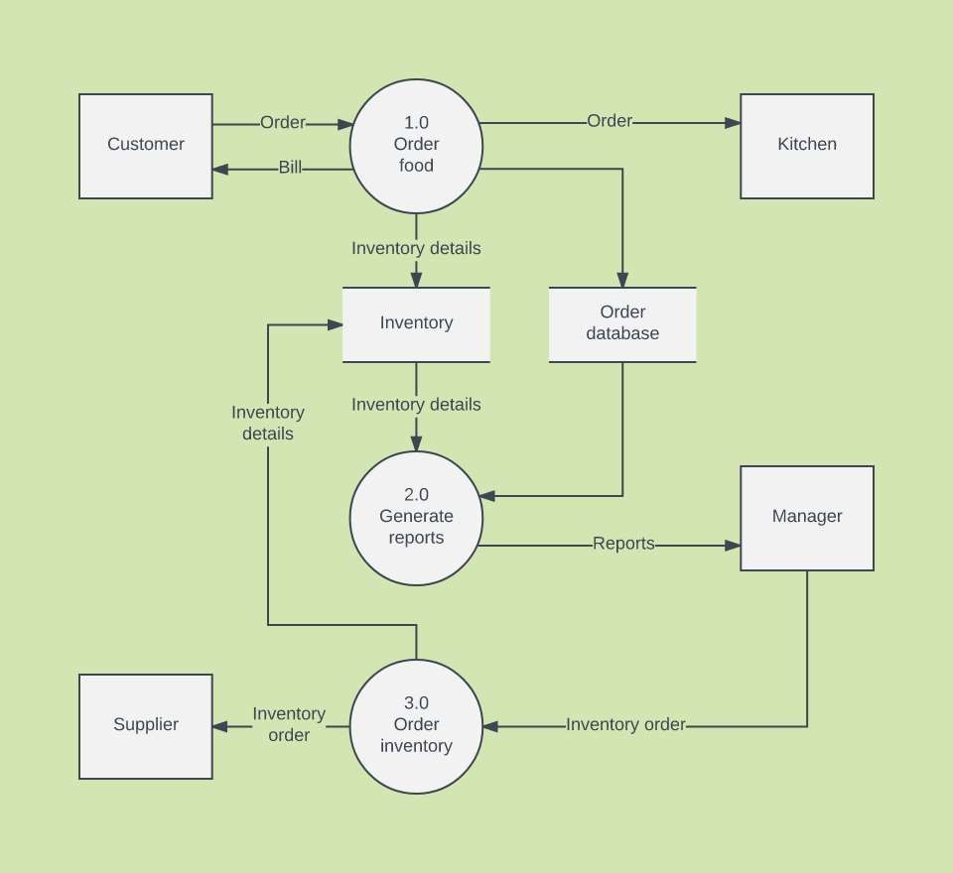
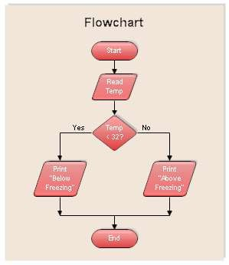
Unit 3- Design
3.4- DFD
3.5- Flow Chart

Slide 2
Data Flow Diagrams (DFDs)
The DFD is a simple graphical formalism that can be used to represent a system in terms of
the input data to the system,
various processing carried out on those data, and
the output data generated by the system.

Slide 3
Data Flow Diagrams (DFDs)
Starting with a set of high-level functions that a system performs, a DFD model represents the sub-functions performed by the functions using a hierarchy of diagrams
In a hierarchical model, starting with a very abstract model of a system, various details of the system are slowly introduced through different levels of the hierarchy.
We now elaborate the different concepts associated with building a DFD model of a system.

Slide 4
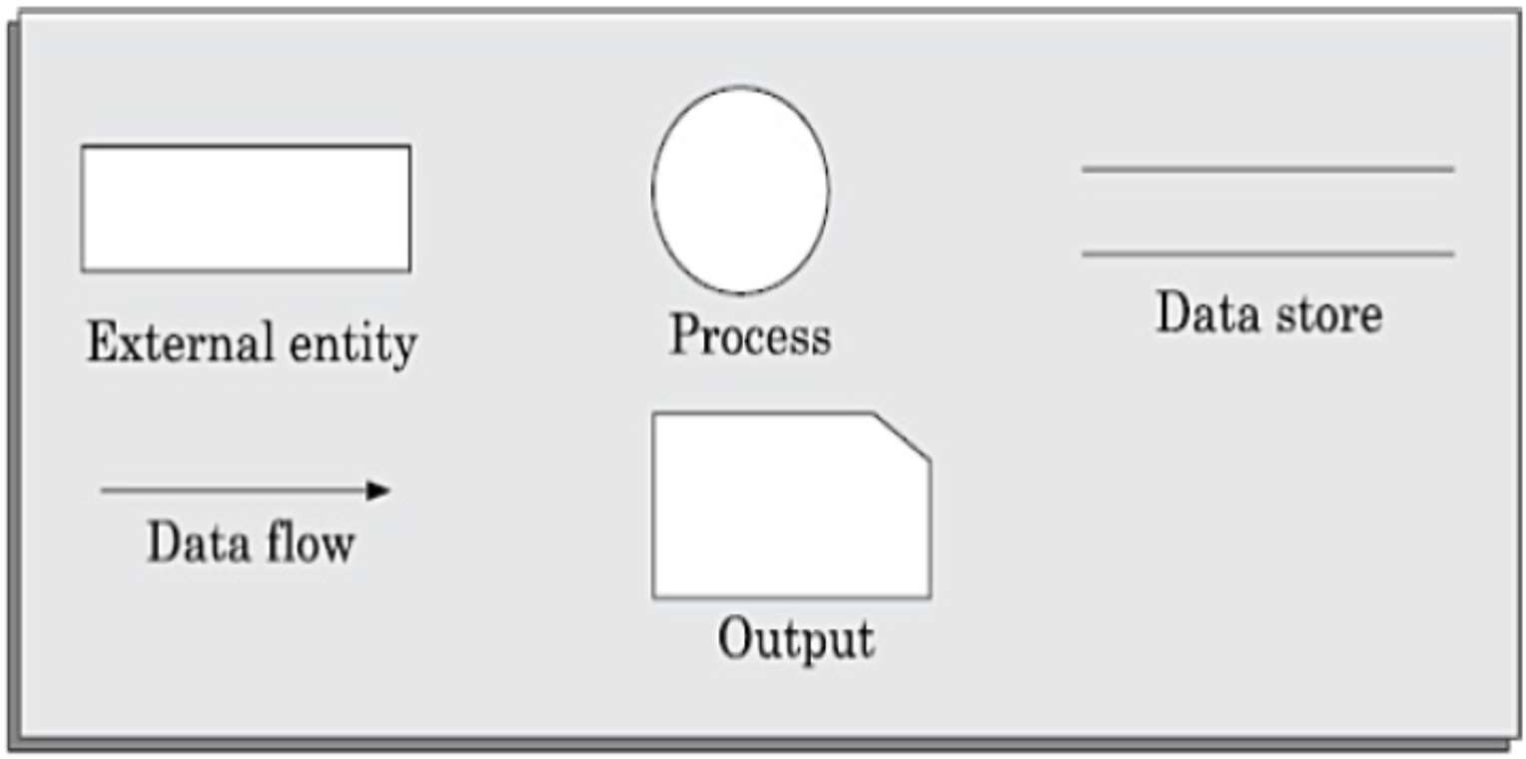
Primitive symbols used for constructing DFDs
There are essentially five different types of symbols used for constructing DFDs. These primitive symbols are depicted in following Figure:

Slide 5
Function symbol: A function is represented using a circle.
This symbol is called a process or a bubble. Bubbles are annotated with the names of the corresponding functions.
External entity symbol: Represented by a rectangle. Essentially those physical entities external to the software system which interact with the system by inputting data to the system or by consuming the data produced by the system.
In addition to the human users, they can be used to represent external hardware and software such as another application software that would interact with the software being modelled.
Data flow symbol: A directed arc (or an arrow) is used as a data flow symbol.
A data flow symbol represents the data flow occurring between two processes or between an external entity and a process in the direction of the data flow arrow.
Data flow symbols are usually annotated with the corresponding data names.

Slide 6
Data store symbol: A data store is represented using two parallel lines.
It represents a logical file. That is, a data store symbol can represent either a data structure or a physical file on disk.
Each data store is connected to a process by means of a data flow symbol.
The direction of the data flow arrow shows whether data is being read from or written into a data store.
Output symbol: The output symbol is used when a hard copy is produced.

Slide 7
Rules and tips for DFD
Each process should have at least one input and an output.
Each data store should have at least one data flow in and one data flow out.
Data stored in a system must go through a process.
All processes in a DFD go to another process or a data store.

Slide 8
DFD Example

Slide 9
Creating Data Flow Diagrams
Steps:
Create a list of activities
Construct Context Level DFD
(identifies external entities and processes)
Construct Level 0 DFD
(identifies manageable sub process )
Construct Level 1- n DFD
(identifies actual data flows and data stores )
Check against rules of DFD

Slide 10
DFD Naming Guidelines
External Entity → Noun
Data Flow → Names of data
Process → verb phrase
a system name
a subsystem name
Data Store → Noun

Slide 11

Creating Data Flow Diagrams Lemonade Stand Example

Slide 12
Creating Data Flow Diagrams
Example
The operations of a simple lemonade stand will be used to demonstrate the creation of dataflow diagrams.
Steps:
1. Create a list of activities
Old way: no Use-Case Diagram
New way: use Use-Case Diagram
Construct Context Level DFD (identifies sources and sink)
Construct Level 0 DFD
(identifies manageable sub processes )
Construct Level 1- n DFD
(identifies actual data flows and data stores )

Slide 13
Creating Data Flow Diagrams
Example
Think through the activities that take place at a lemonade stand.
1. Create a list of activities
Customer Order Serve Product Collect Payment Produce Product Store Product

Slide 14
Creating Data Flow Diagrams
Example
Also think of the additional activities needed to support the basic activities.
1. Create a list of activities
Customer Order Serve Product Collect Payment Produce Product Store Product
Order Raw Materials Pay for Raw Materials Pay for Labor

Slide 15
Creating Data Flow Diagrams
Example
Group these activities in some logical fashion, possibly functional areas.
1. Create a list of activities
Customer Order Serve Product Collect Payment
Produce Product Store Product
Order Raw Materials Pay for Raw Materials
Pay for Labor

Slide 16

Creating Data Flow Diagrams
Example
Create a context level diagram identifying the sources and sinks (users).
2. Construct Context Level DFD (identifies sources and sink)
Context Level DFD
CUSTOMER
Order
Sales Forecast
0.0
Lemonade System
Production Schedule_{EMPLOYEE}
Customer Order Serve Product Collect Payment
Product Served Payment
Pay
Time Worked
Received Goods Payment
Purchase Order
Produce Product Store Product
VENDOR
Order Raw Materials Pay for Raw Materials
Pay for Labor

Slide 17
Creating Data Flow Diagrams
Example
Create a level 0 diagram identifying the logical subsystems that may exist.
3. Construct Level 0 DFD
(identifies manageable sub processes )
Level 0 DFD
1.0
Sale
Customer Order Serve Product Collect Payment
Customer Order
Sales Forecast
Product Ordered Payment
2.0
CUSTOMER
Production Schedule
EMPLOYEE
Product Served
Production
Produce Product Store Product
Received Goods
Inventory
VENDOR
3.0
Procure- ment
Order Raw Materials Pay for Raw Materials
Purchase Order
Payment
Order Decisions
Pay
Time Worked
Pay for Labor
4.0
Payroll

Slide 18



Creating Data Flow Diagrams
Example
Create a level 1 decomposing the processes in level 0 and identifying data stores.
Customer Order Serve Product Collect Payment
4. Construct Level 1- n DFD
(identifies actual data flows and data stores )
Level 1 DFD
CUSTOMER
Customer Order
ORDER
Request for Forecast
1.1
Record Order
1.3
Produce Sales Forecast
Produce Product Store Product
Severed Order
Payment
Sales Forecast
1.2
Receive Payment
PAYMENT
Order Raw Materials Pay for Raw Materials
Pay for Labor

Slide 19
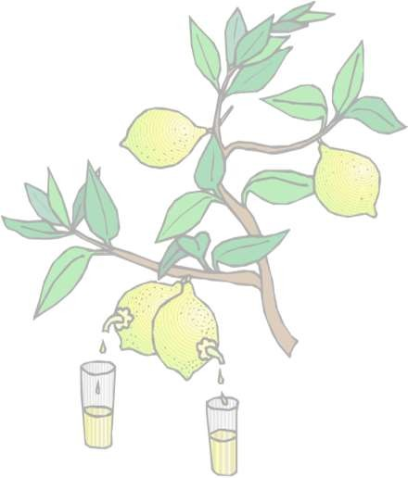
Creating Data Flow Diagrams
Example
Create a level 1 decomposing the processes in level 0 and identifying data stores.
Customer Order Serve Product Collect Payment
4. Construct Level 1 (continued)
Level 1 DFD
Product Order
ORDER
2.1
Serve Product
Quantity Severed
Production Schedule
RAW MATERIALS
Produce Product Store Product
2.2
Produce Product
Quantity Used
Order Raw Materials Pay for Raw Materials
Production Data
INVENTORTY
2.3
Store Product
Quantity Produced & Location Stored
Pay for Labor

Slide 20

Creating Data Flow Diagrams
Example
Create a level 1 decomposing the processes in level 0 and identifying data stores.
Customer Order Serve Product Collect Payment
4. Construct Level 1 (continued)
Level 1 DFD
PURCHASE ORDER
Order Decision
3.1
Produce Purchase Order
Quantity On-Hand
RAW
Quantity Received
MATERIALS
Received Goods
Produce Product Store Product
3.2
Receive Items
RECEIVED ITEMS
Order Raw Materials Pay for Raw Materials
Payment Approval
3.3
Pay Vendor
VENDOR
Pay for Labor
Payment

Slide 21

Creating Data Flow Diagrams
Example
Create a level 1 decomposing the processes in level 0 and identifying data stores.
Customer Order Serve Product Collect Payment
4. Construct Level 1 (continued)
Level 1 DFD
Time Worked
4.1
Record Time Worked
TIME CARDS
Employee ID
EMPLOYEE
Payroll Request
Produce Product Store Product
4.2
Calculate Payroll
Unpaid time cards
PAYROLL
Order Raw Materials Pay for Raw Materials
Payment Approval
4.3
Pay Employe e
Pay for Labor
PAYMENTS
Payment

Slide 22


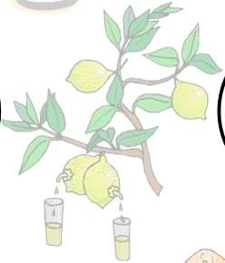
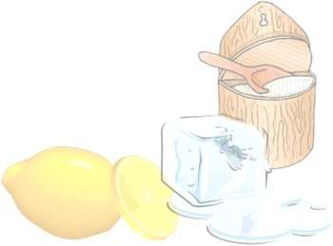

Process Decomposition
1.0
Sale
1.1
Record Order
1.2
Receive Payment
2.0
Production
2.1
Serve Product
2.2
Produce Product
2.3
Store Product
0.0
Lemonade System
3.0
Procure- ment
3.1
Produce Purchase Order
3.2
Receive Items
3.3
Pay Vendor
4.0
Payroll
4.1
Record Time Worked
4.2
Calculate Payroll
4.3
Pay Employe e
Context Level
Level 0
Level 1

Slide 23

Data Flow Model of a Car Assembly Unit
Engine Store
Door
Store
Partly Assembled
Fit
^{Engine} Chassis
Fit Doors
Car
Fit Wheels
Paint and Test
Assembled
Car
with Engine
Car
Chassis Store
Wheel
Store

Slide 24
What is a flowchart
A flowchart is a diagram that depicts a process, system or computer algorithm.
They are widely used in multiple fields to document, study, plan, improve and communicate often complex processes in clear, easy-to-understand diagrams.
Flowcharts use rectangles, ovals, diamonds and potentially numerous other shapes to define the type of step, along with connecting arrows to define flow and sequence

Slide 25
When it is used
To develop understanding of how a process is done.
To study a process for improvement.
To communicate to others how a process is done.
When better communication is needed between people involved with the same process.
To document a process.

Slide 26
Common Flowchart Symbols
Terminator: An oval flow chart shape indicating the start or end of the process.
Process: A rectangular flow chart shape indicating a normal process flow step.
Decision: A diamond flow chart shape indication a branch in the process flow.
Connector: A small, labeled, circular flow chart shape used to indicate a jump in the process flow. (Shown as the circle with the letter “A”, below.)
Data: A parallelogram that indicates data input or output (I/O) for a process.
Document: Used to indicate a document or report

Slide 27
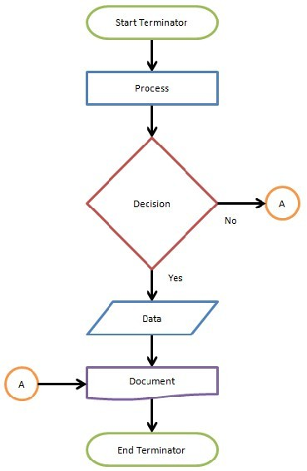

Slide 28
